Slide 1



FARMING
ASSISTANT
Empowering Farming!
Cultivating Success
Presented By
Abhinav Singh
Sanjay Haritwal

Slide 2

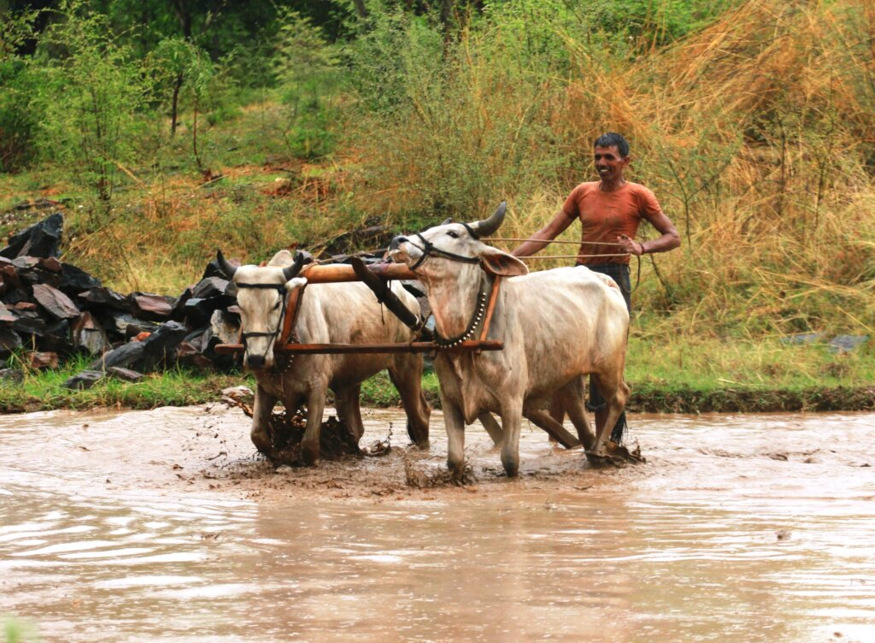
WELCOME
We're thrilled to have you join our growing community of dedicated farmers and enthusiasts. Whether you're a seasoned farmer or just starting out, Farming Assistant is here to simplify and enhance your farming experience.

Slide 3
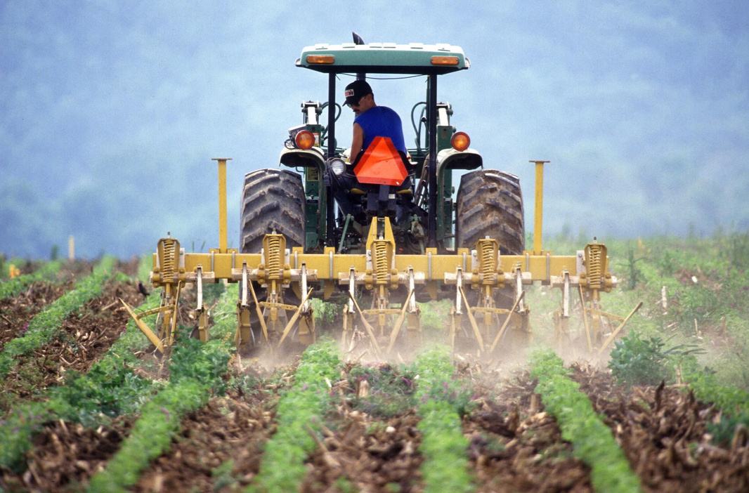


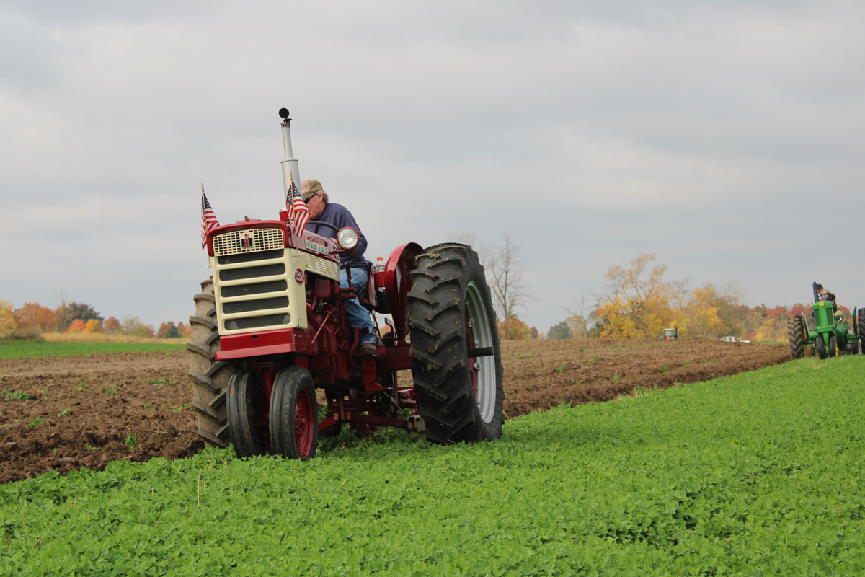

MISSION
Empowering farmers with knowledge and tools to optimize their yields, conserve resources, and foster sustainable farming practices. Together, we cultivate a greener future.
VISION
Empowering farmers with cutting-edge technology, our vision is to revolutionize agriculture. Seamlessly connecting farmers, resources, and knowledge, we aim to optimize yields, sustainability, and global food security. Together, we'll cultivate a brighter future.

Slide 4

01
02
03
RANDOM WEATHER
CROP MANAGEMENT
SOIL MANAGEMENT
unpredicted heavy rainfall
Irregular Monsoon
Temperature Irregularities
Same crop over and over
Improper crop plantation
Miss use of water
irregular irrigation
Overgrazing
PROBLEMS
THAT OUR FARMERS FACE

Slide 5

OUR
SOLUTIONS
01
Weather Alerts
02
Land Degradation
03
Voice Controlled
04
Market Update

Slide 6
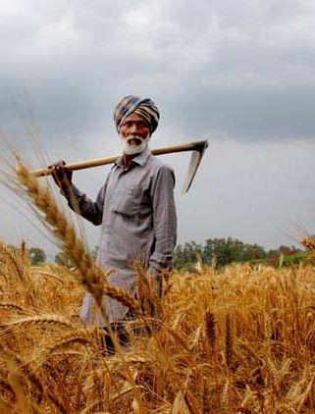
IN TO THE
RESCUE
7 days weather updates
Notify about Government Subsidies and notification
Crop suggestion based on geo-location

Slide 7

THANK
YOU

